Slide 1

a greedy fact on Affiliate Marketing.
A just beginner affiliate marketer earns a minimum of Rs10,000 per month. And an affiliate marketer with just 1 year of experience can earn up to Rs5,00,000+ per annum. I am not exaggerating the amount. I told you the minimum amount. Affiliate Marketing is the highest paid profession with no income limit.

Slide 2

Affiliate marketing
A great opportunity of earn money

Slide 3

How To Start Affiliate Marketing?

Slide 4
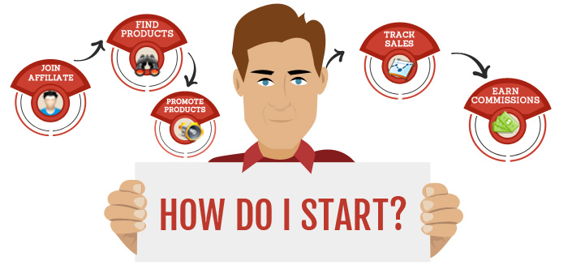
Build Clear and Strong Foundation of your Affiliate Marketing Career
STEP : A
1 . Build Clear and Strong Foundation of your Affiliate Marketing Career
2 . decide a platform
3 . find your affiliate marketing niche
4 . types of affiliation
5 . Tasks to be completed

Slide 5


decide a platform
The very first step is to “Decide a Platform” where you will do affiliation. The major platforms where you can do affiliation are:
1 . Blogs
2 . Facebook
3 . YouTube
4 . Paid Ads
5 . Instagram
6 . Forums

Slide 6


find your affiliate marketing niche
Stats estimates that the number of bloggers in the U.S will reach 40 million by 2021. So to stand the best chance of success, niche down. In simple words, choose a sub-niche under your niche. Choose a sub-niche that focuses on a specific category.
Health, Fitness and Weight Loss
Dating and Relationships
Pet care
Technology
Fashion and Beauty

Slide 7

types of affiliation
There are three types of affiliate programs to choose from.
Low appealing niche products with high payouts(Example: Hosting services)
High appealing niche products with low payouts(Example: Games)
Affiliate programs for high appealing niche products with high payouts(Example: Credit Cards)

Slide 8

Tasks to be completed
There are two tasks should be complete for better result
Deciding of niche and sub-niche(priority should be your interest before money)
Building your platform(atleast two) for affiliation

Slide 9
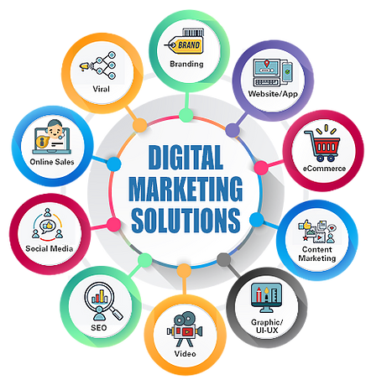
Create a environment
for Affiliate Marketing
STEP : B
1 .
2 . which platform to choose for affiliate?
3 . how to get approval in affiliate marketing?
4 . take care of these points:
5 . Tasks to be completed

Slide 10

which platform to choose for affiliate?
There are some affiliate site .here we can affiliate start
1 . ShareASale
2. Awin
3 . Amazon Associates
4. CJ Affiliate
5 . Rakuten Advertising
6 . Avangate Affiliate Network
7 . ClickBank
8 . Peerfly
9 . FlexOffers
10 . Walmart
11 . Aliexpress
12 . Flipcart

Slide 11

how to get approval in affiliate marketing?
There are some affiliate site .here we can affiliate start
Now a big issue is that many of the platforms ask about how will you affiliate. They won’t approve your account until they feel that you are a good match. This is not only for the platform. After getting approval on the platform, when you will do affiliate for a particular product, again you will have to ask for the approval of your application. Many people fail here. Let me help you with the approval procedure…

Slide 12


take care of these points
So how will you promote the product? They will definitely ask this question. Tell the affiliate manager how you propose to promote and send traffic to the merchant. Whether you use SEO, paid search, email marketing, social media or whatever have you, showing a prospective program that you have a plan that has been devised specifically for their business shows that you have put some thought into your partnership.
Professional email, content should be of high quality, send trafic
If you’re signing up to a new affiliate program with any email, make sure it should look like professional or should represent your website, brand or whatever name you have given to your social media platform(if you made any). Having a professional email won’t necessarily stop an affiliate manager from scrutinizing your application. For Example:petcare@gmail.com
Next factor is the content we are providing on your social media platform or website. That content should be of high quality and appealing.
you will get approval

Slide 13
Tasks to be completed
There are two tasks should be complete for better result
Choose 2 affiliation platforms at most.
Note down the list of products you are going to promote, basically your niche products.
Make a free website or social media profile if you feel a need of it. Because you have to put the link of this every time.
Have a professional look-like email related to your niche or name of brand or website.
Get approval on the platforms you applied for.

Slide 14
Choose Affiliate products
STEP : C
1 . Choose Affiliate products
2 . The calculation for selection of Affiliate products
3 . time span of commission
4 . Before you pick affiliate products
5 . Tasks to be completed

Slide 15

Choose Affiliate products
There are two tasks should be complete for better result
Choose 2 affiliation platforms at most
Note down the list of products you are going to promote, basically your niche products.
Make a free website or social media profile if you feel a need of it. Because you have to put the link of this every time.
Have a professional look-like email related to your niche and name of brand or website.
Get approval on the platforms you applied for.

Slide 16
Choose Affiliate products
There are two tasks should be complete for better result
A Blog
A comparison of deals and discount website
A YouTube channel
A Podcast
An email newsletter
Social media platform
Ad platforms.

Slide 17
Tasks to be completed
There are two tasks should be complete for better result
Research about multiple products available on your affiliate platform
Make a list of products you want to apply for

Slide 18

Six Things Successful Affiliate Marketers Do Right
1 . Focus on quality leads, not quantity.
2 . Put your audience first.
3 . It’s about conversion rates, not commissions.
4 . Build a subscriber list.
5 . Track your efforts.

Slide 19

Thank you
baharulislam4145@gmail.com
http://www.example.com/

